Slide 1
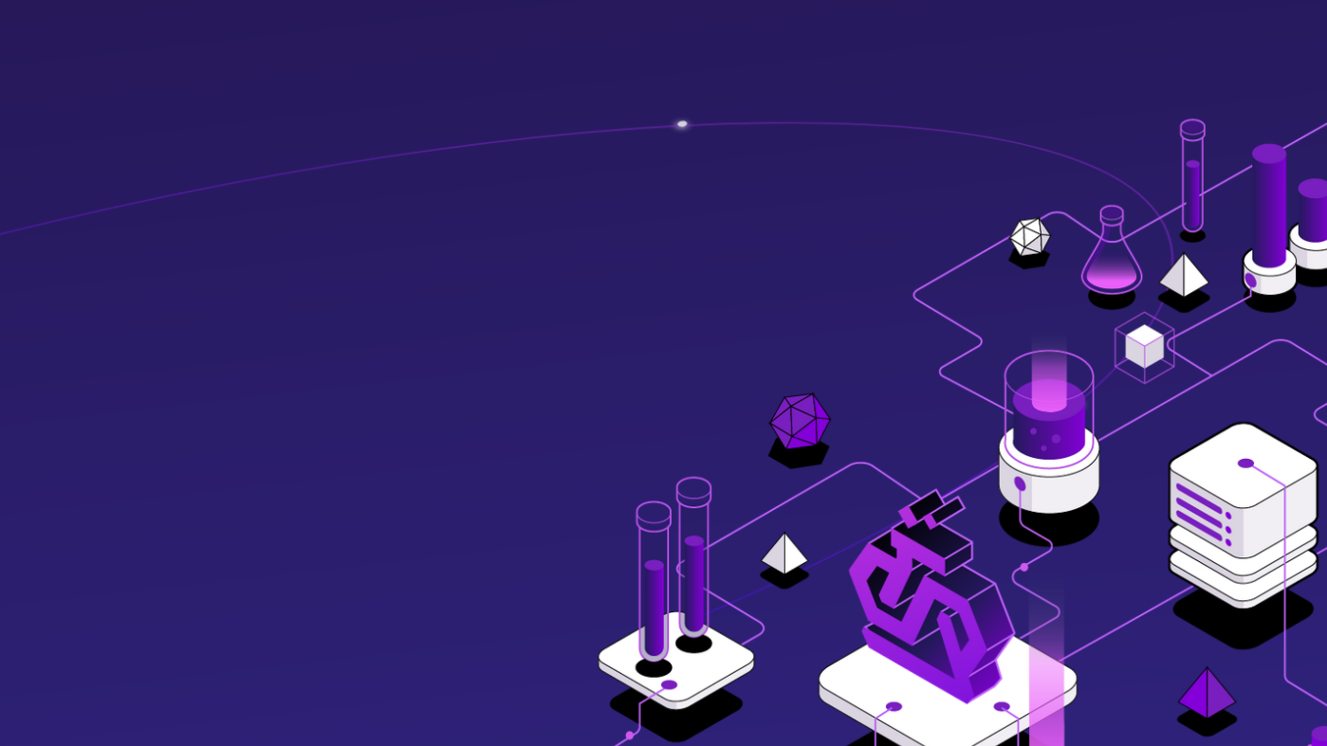
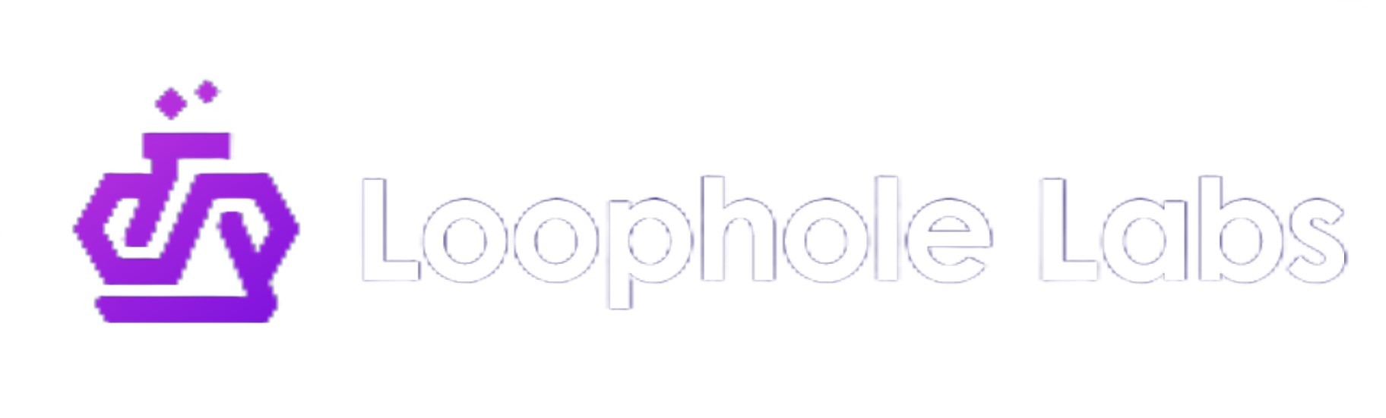
Commoditize Your CI Compute:
Spot Instances Without the Spotty Reliability
Felicitas Pojtinger (maintainer of Drafter)
@pojntfx
Notes:
Hi everyone! I'm Felicitas - Fel for short - from Loophole Labs.
We've heard lots of fascinating talks in these past few days about finding bugs, fixing them, and writing more reliable software in general.
This talk takes a bit of a step back to look at something more fundamental: the actual compute infrastructure that we run our CI/CD pipelines on.
This is a bit of a speedrun - I'm condensing what's normally a 35-minute talk into just 8 minutes, including a live demo - so buckle up!

Slide 2
Are you running your CI/CD on spot instances?
Notes:
I'd like to start with a quick show of hands: Who here is running their CI/CD on spot instances or other forms of ephemeral compute right now? [PAUSE]
That's what I thought - and I don't blame you! But it does seems a bit strange at first, right?

Slide 3
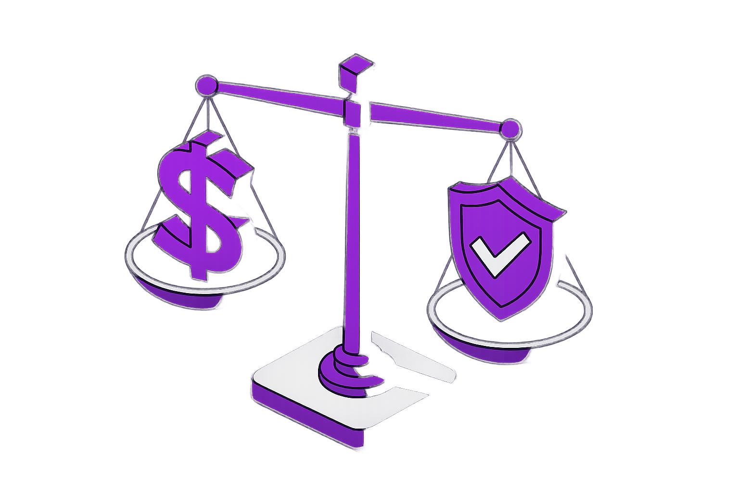
Pay only for what you use
70-90% savings
Better for cloud providers, too
Notes:
Spot instances offer lots of benefits after all:
They save 70-90% of costs compared to on-demand,
you pay only for what you use,
and when you use them, they're even more efficient for cloud providers too since they can reclaim capacity when needed.

Slide 4
30-120s
Notes:
So why isn't everyone using them?
To us, it’s the 30-120 second termination notice after which the host and all its data gets deleted, which is catastrophic for stateful workloads like long-running builds, GPU training, and integration tests.

Slide 5
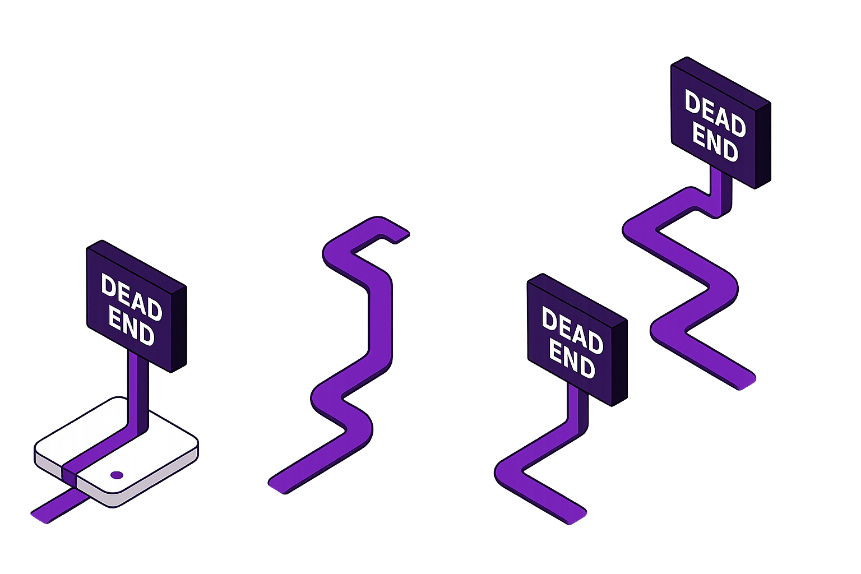
❌ Complex custom checkpointing
❌ Spots only for stateless jobs
❌ Expensive on-demand instances
❌ Accept failures and retry
Notes:
It's undeniable that the current "solutions" to get around this are all compromises:
You either don't use spot at all and overpay for on-demand,
limit yourself to stateless jobs which aren’t that useful,
build complex custom checkpointing for each application (which is popular in the AI space),
or accept failures/retries and make everything idempotent, which requires lots of engineering work.

Slide 6
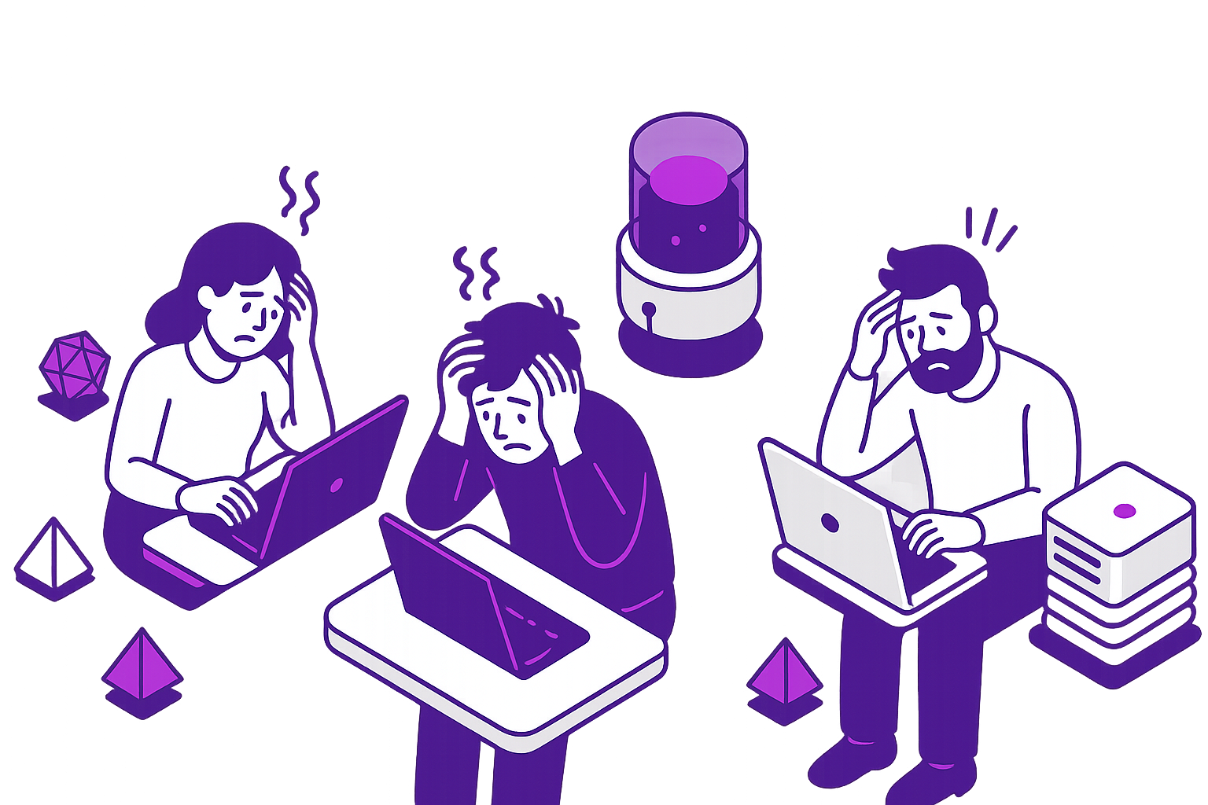
Fewer tests that don’t run for each commit
Short or no benchmarks
No or little fuzzing
€$¥
Notes:
This has real consequences.
Even medium-sized teams can waste hundreds of thousands annually on on-demand instances (even a startup like us spends a few grand per month), and those costs lead to real issues:
fewer tests are being written,
tests aren't running on every commit,
there are short benchmarks or no benchmarks at all
and often there is no fuzzing.

Slide 7
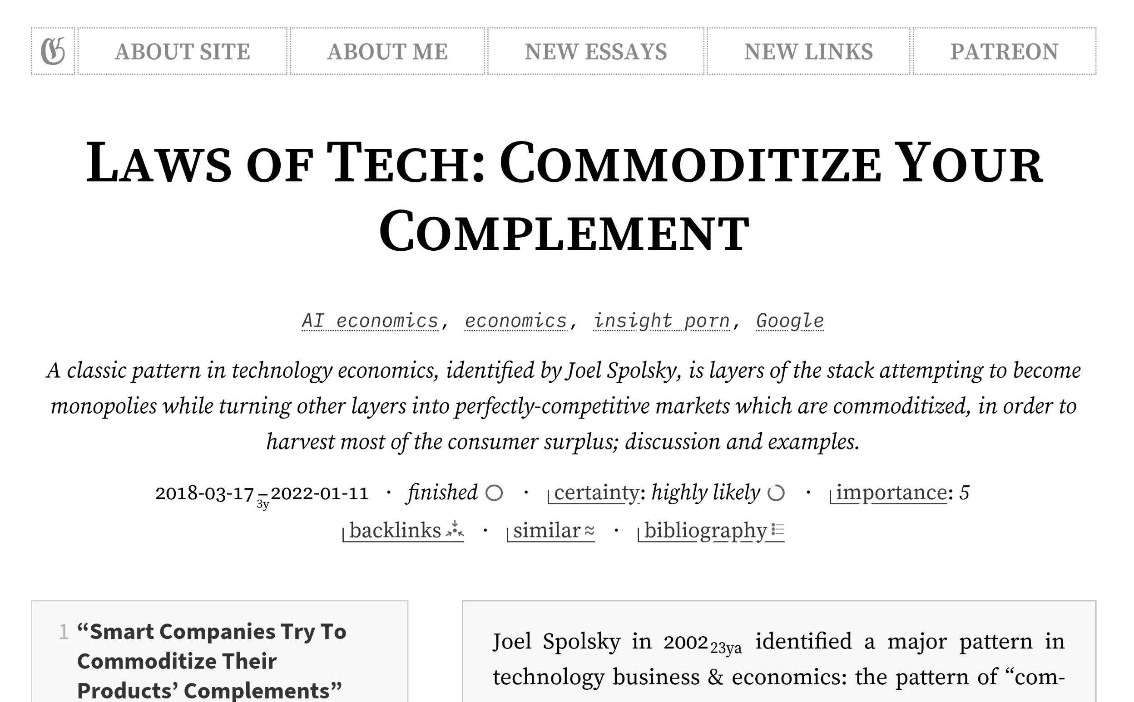
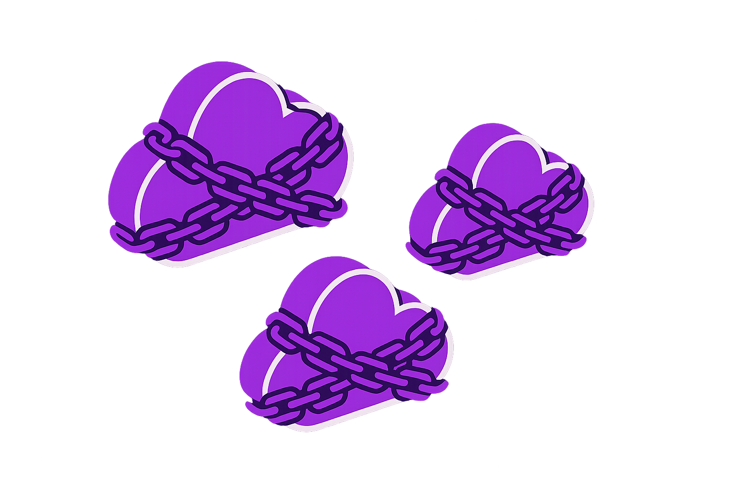
https://gwern.net/complement
Notes:
And finally, this goes beyond just cost, it's also about digital sovereignty.
Proprietary ecosystems like AWS prevent switching between clouds and there's no true workload portability between providers.
Cloud providers themselves follow the "Law of Complements" - monopolizing compute while commoditizing the layers below, but as a user of those cloud providers you can't do that yourself.

Slide 8
“A unified, failure-proof compute fabric”
Notes:
This is where Architect comes in - it allows you to commoditize your completent, the cloud provider.
The core goal is to create a "unified failure-proof compute fabric" based on spot instances from any number of cloud providers.

Slide 9
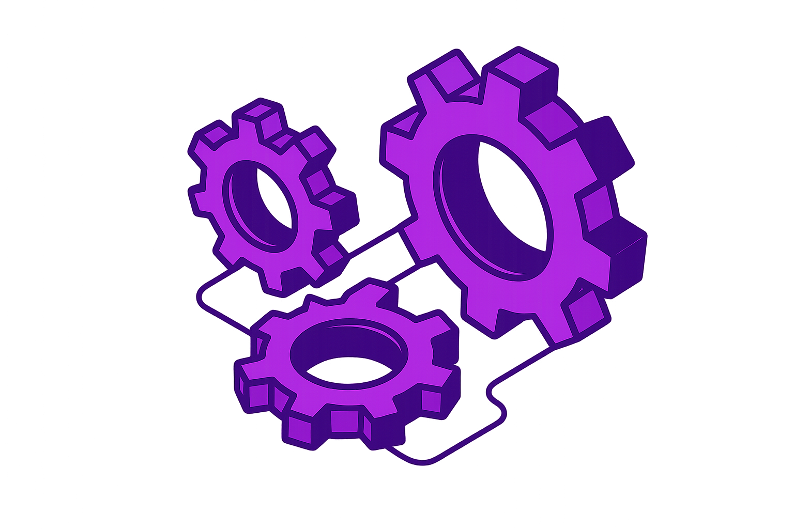
Cloud-agnostic (AWS, GCP, Azure, on-prem etc.) VM images and snapshots
Very fast live migration
Zero code changes needed
Notes:
Three key capabilities make this possible: First, cloud-agnostic VM images and snapshots - we're not replacing VMs with containers, but creating actual KVM-based VMs that run everywhere.
Second, Quick live migration - faster than the 30-120s termination notice, allowing you to use spot instances as if they were regular on-demand instances;
and third, zero code changes are necessary - there is support for the entire compute stack (CPU/GPU/disk/network) even as a migration is happening, nothing ever goes away or errors out.

Slide 10
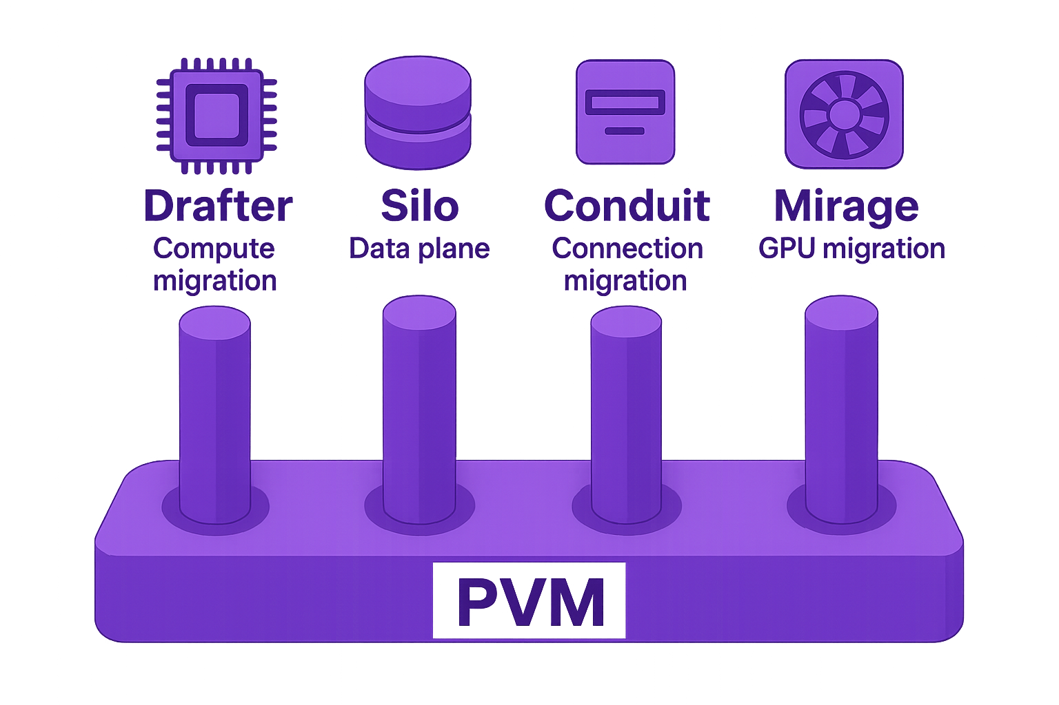
Notes:
And this is the tech stack that makes it all possible: Drafter, Silo, Conduit and Mirage powered by PVM.

Slide 11
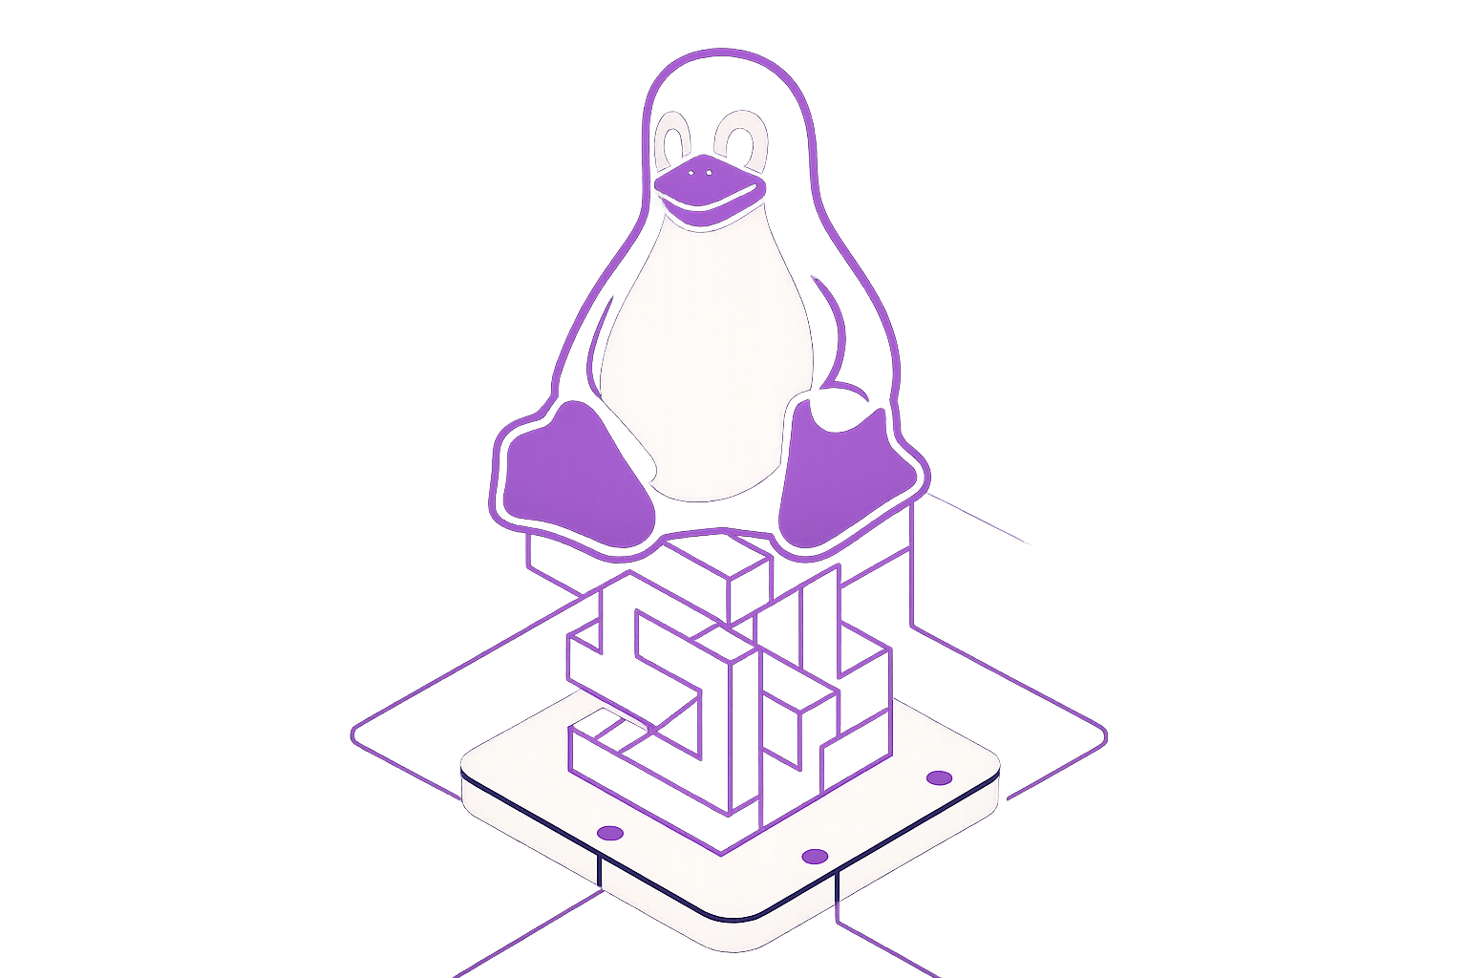
PVM: Pagetable Virtual Machine
Performance overhead <10% compared to host
Run VMs on VMs
without nested virtualization or emulation
Custom Loophole Labs patches for live migration
Notes:
The first component I want to introduce is PVM (Pagetable Virtual Machine), a new Linux patchset first posted last year that allows running VMs on top of VMs. [BREATHE]
Unlike nested virtualization, it doesn't need software emulation or bare metal instances - no consent or buy-in from the cloud providers is needed, it works anywhere that Linux runs.
With our custom Loophole Labs patches for live migration, performance overhead is under 10%, far below the cost savings you get.

Slide 12
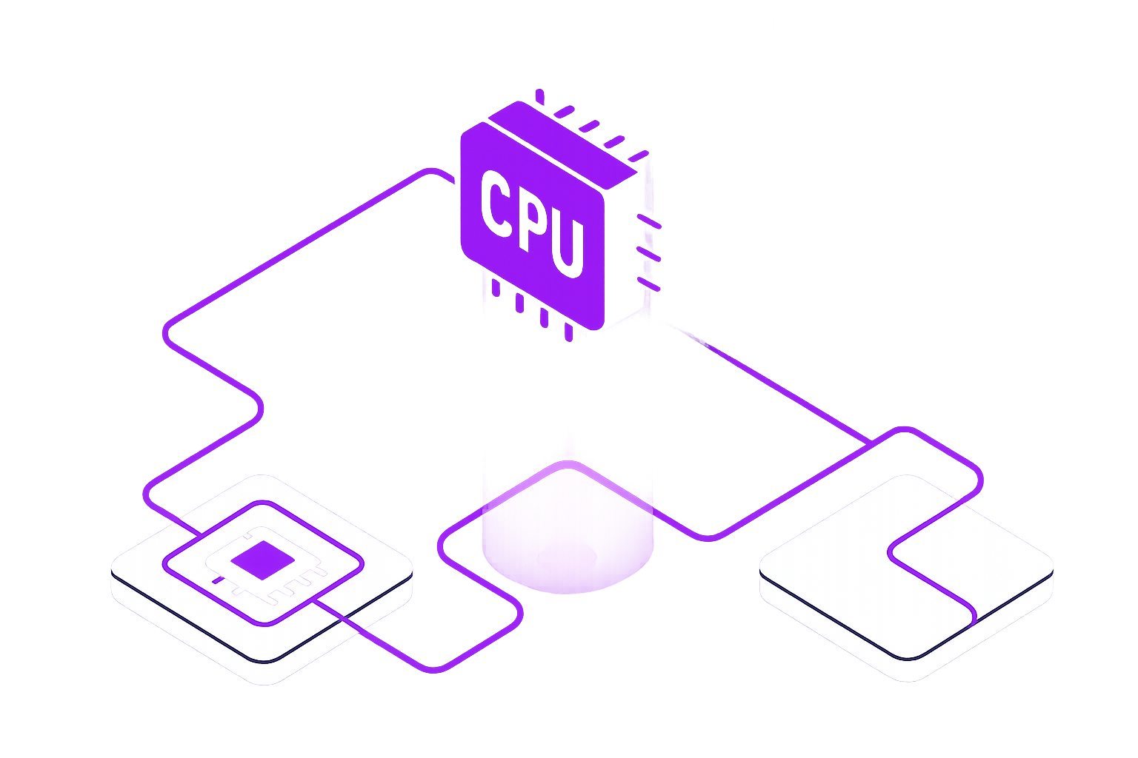
Drafter: Compute Unit
Hypervisor with first-class live migration support
Normalizes CPU feature sets across hosts
Based on our fork of Firecracker
Notes:
Drafter is our open-source unit of compute with first-class live migration support.
It's written in Go and based on Firecracker, which allows it to normalize CPUs across hosts for safe migrations between heterogeneous environments.
We use it with our customized Firecracker fork that supports continuous tracking of memory changes during runtime.

Slide 13
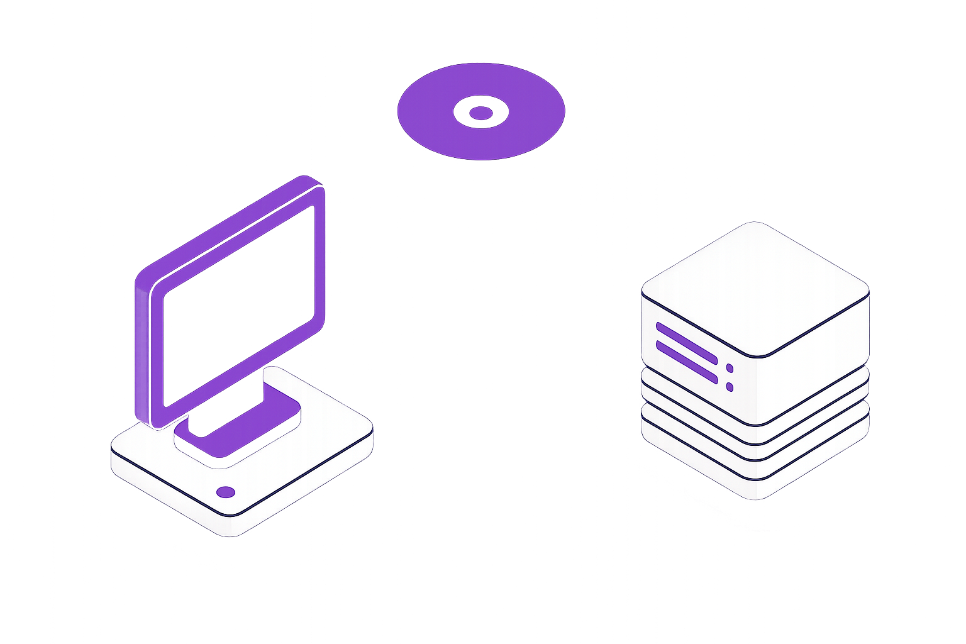
Silo: Data Migration System
Prioritizes important blocks over P2P connection and falls back to S3
Tracks disk & memory changes and learns access patterns
Continuously backs up to S3
Notes:
Silo manages data migration and is also open-source.
It continuously tracks changes to disk and memory and learns access patterns,
which it then uses to create continuous backups that are synced to S3 asynchronously while the VM runs. [BREATHE]
When the actual migration happens, it prioritizes the most-needed chunks first over a P2P connection based on those learned patterns, and fetches the last-needed chunks from S3 so that the source host can be shut down ASAP.

Slide 14
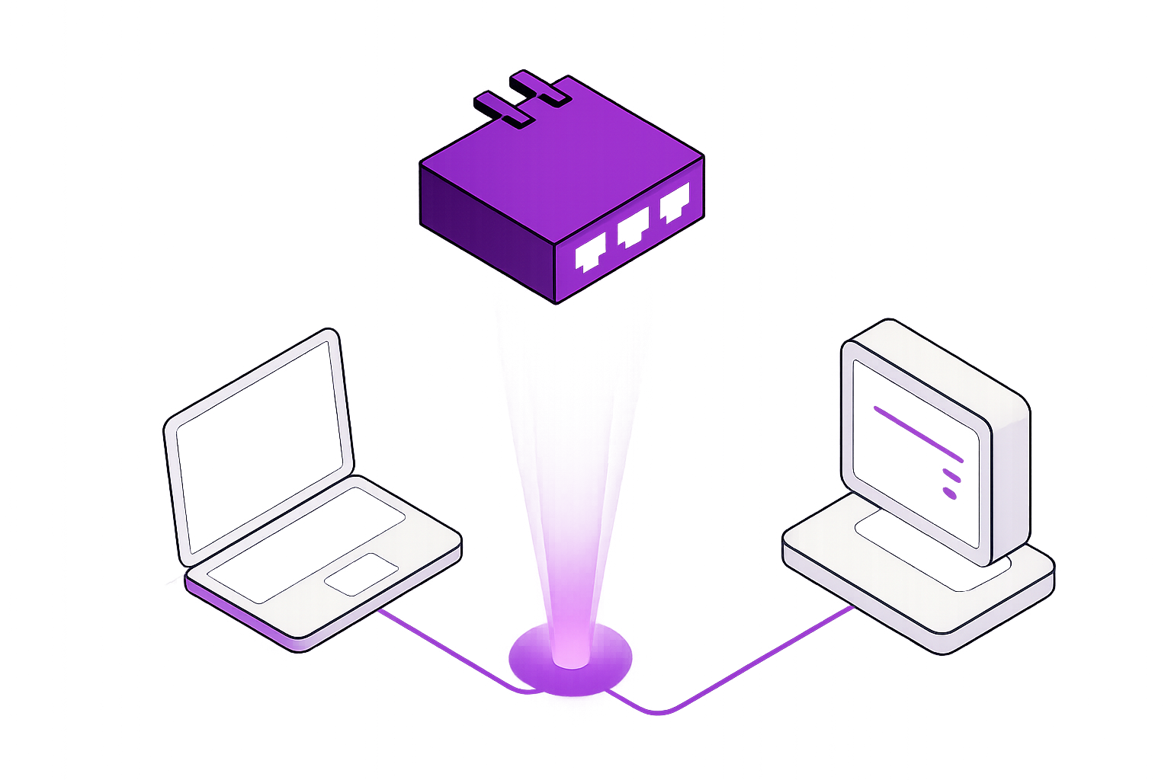
Conduit: Network Migration
Supports migrating ingress & egress traffic
Written in eBPF:
Runs on network card at line speed
Works on L3 (both UDP & TCP are supported)
Notes:
Conduit solves the problem of the IP address changing after you've migrated from source to destination, which usually breaks connections.
It’s is written in eBPF, which means it runs directly on network cards and runs at essentially line speed.
Both ingress and egress connection migrations of any layer 3 protocol are supported, so downloads that the guest has started before or during a migration for example won't be interrupted.
It's a bit out of scope for this talk, but I'll link a different, more in-depth talk I did on this at the end.

Slide 15
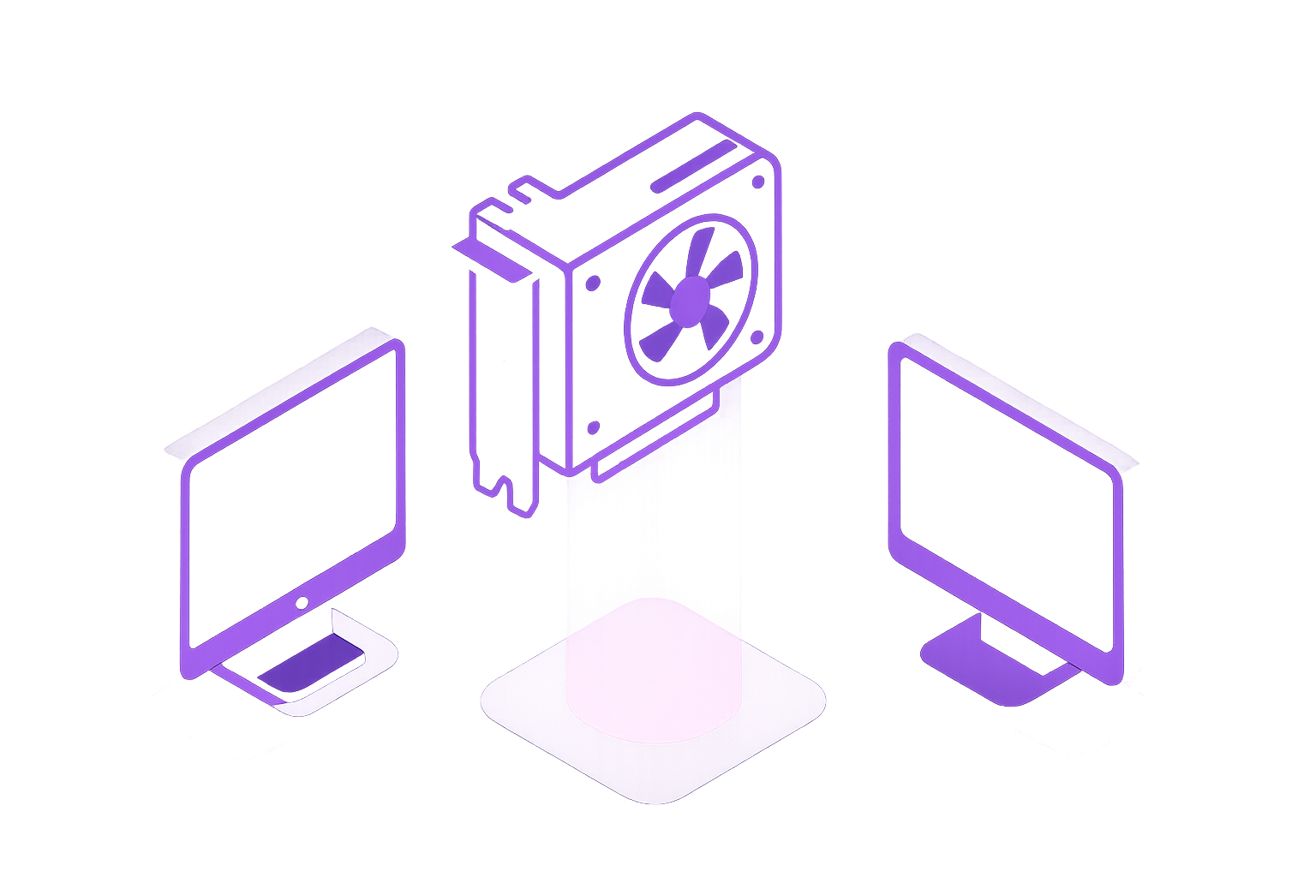
Mirage: GPU Workload Migration
Supports both inference and training
Zero application changes needed
Supports migrating a workload between heterogeneous hosts and GPUs
Notes:
Mirage is an experimental component that enables live migration of GPU workloads.
It's out of scope for this talk as well and still in closed beta, but if you're interested in this, talk to me afterwards -
it works without any changes to your application,
supports both inference and training,
and can migrate across different types of GPUs too.

Slide 16
Notes:
And finally, Architect is what we like to call the "Migration Policy Engine".
It acts as a kind of orchestrator and exposes a simple, unified API that ties compute, disk, network and GPU migrations together.

Slide 17
Orchestrates Drafter, Silo, Conduit and Mirage
Provisions physical instances from cloud providers
Exposes GitHub actions, Kubernetes and REST API integrations
Migrate closer to your users as access patterns change
Rapidly evacuate from instances after termination notice
Cross-cloud arbitrage: Automatically migrate to cheapest provider
Notes:
It integrates with GitHub actions, Kubernetes and exposes it's own REST API.
It also integrates with the cloud providers to provision the actual pyhsical instances.
Architect makes proactive decisions by rapidly migrating off instances when it receives a spot preemption notice or a maintenance alert,
it can optimize costs by automatically moving to a cheaper cloud provider without downtime with cross-cloud spot arbitrage,
and it can automatically relocate an entire fleet of hosts if access patterns change.
For example, if the East Coast goes to sleep, it can live migrate the entire system to the West Coast without downtime to reduce latency.

Slide 18
Demo:
Live Migrating a Fuzzing Workload Across Cloud Providers Using Architect
Notes:
Enough theory though, I want to show you how this actually works in practice.
For that, I want to migrate the TigerBeetle fuzzer between AWS/GCP/Azure while it continues running as though nothing happened.
This would typically run via Architect's GitHub action integration, but to speed things up (we only have a minute remaining) I'll do it manually.
The OCI image we're running is public too, so you can verify this isn't just smoke and mirrors. [DEMO]

Slide 19
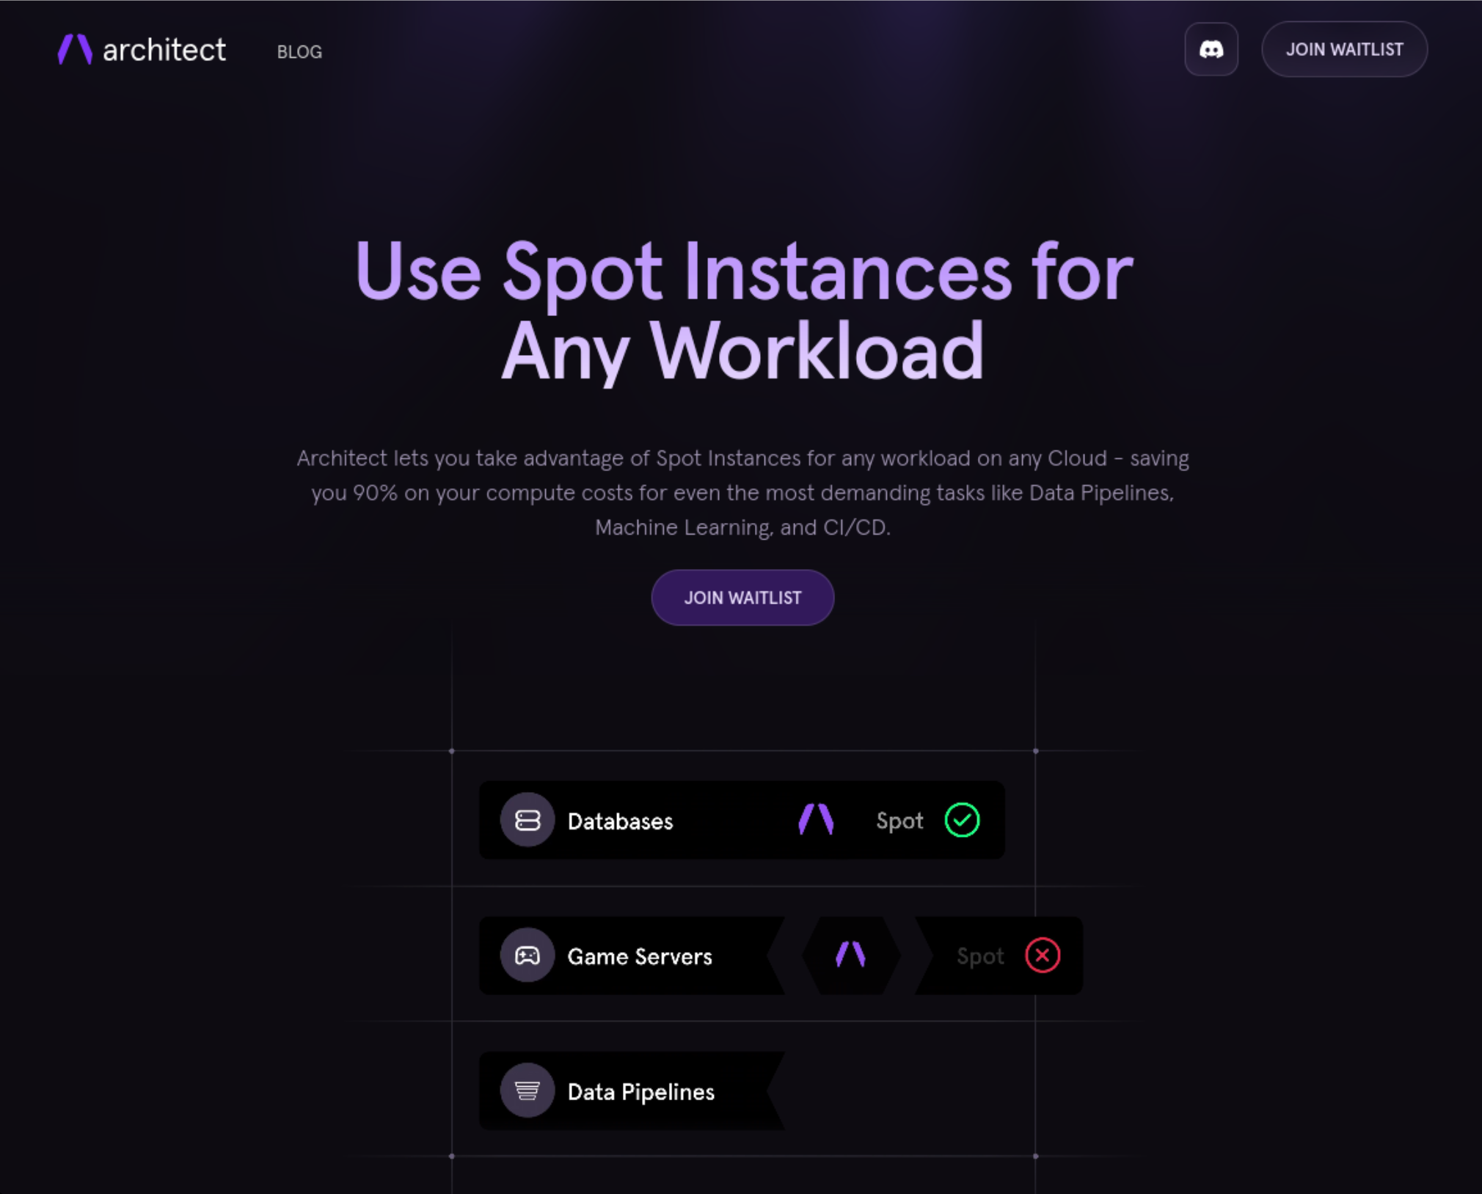



Felicitas
Pojtinger
Fediverse:
Bluesky:
Github:
LinkedIn:
Web:
@pojntfx@mastodon.social
@felicitas.pojtinger.com
@pojntfx in/pojntfx felicitas.pojtinger.com
Waitlist: https://architect.run/
Links & Resources: https://loophole.sh/ bugbash2025
Notes:
If you want to try this out - our public beta is only a few weeks away now, and there is a waitlist at architect.io that you can sign up for.
Our first integration is a GitHub Actions runner powered by Architect that runs in your cloud account on spot instances. If it gets a preemption notice, it automatically spins up a replacement and migrates to it - completely transparent to end-users.
We also have a working Kubernetes integration and support for more CI/CD providers coming.
And with that I'd like to thank you for listening. I hope that this talk has shown that the future of CI/CD isn't about choosing between cost and reliability anymore - it's about having both, on your terms, across any infrastructure of your choosing.
And if you want to know more, I'll be here all day, plus everything from today can be found in this QR code!

